Slide 1
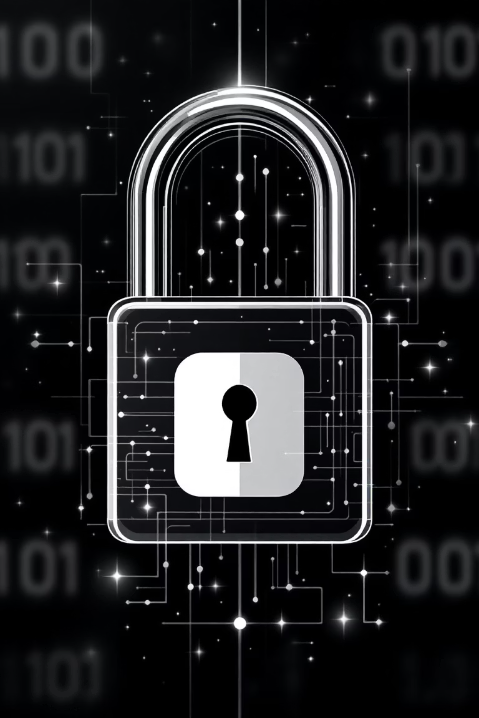

Cybersecurity: Protecting Against Digital Threats
By Sarah, Tom and Baptiste

Slide 2
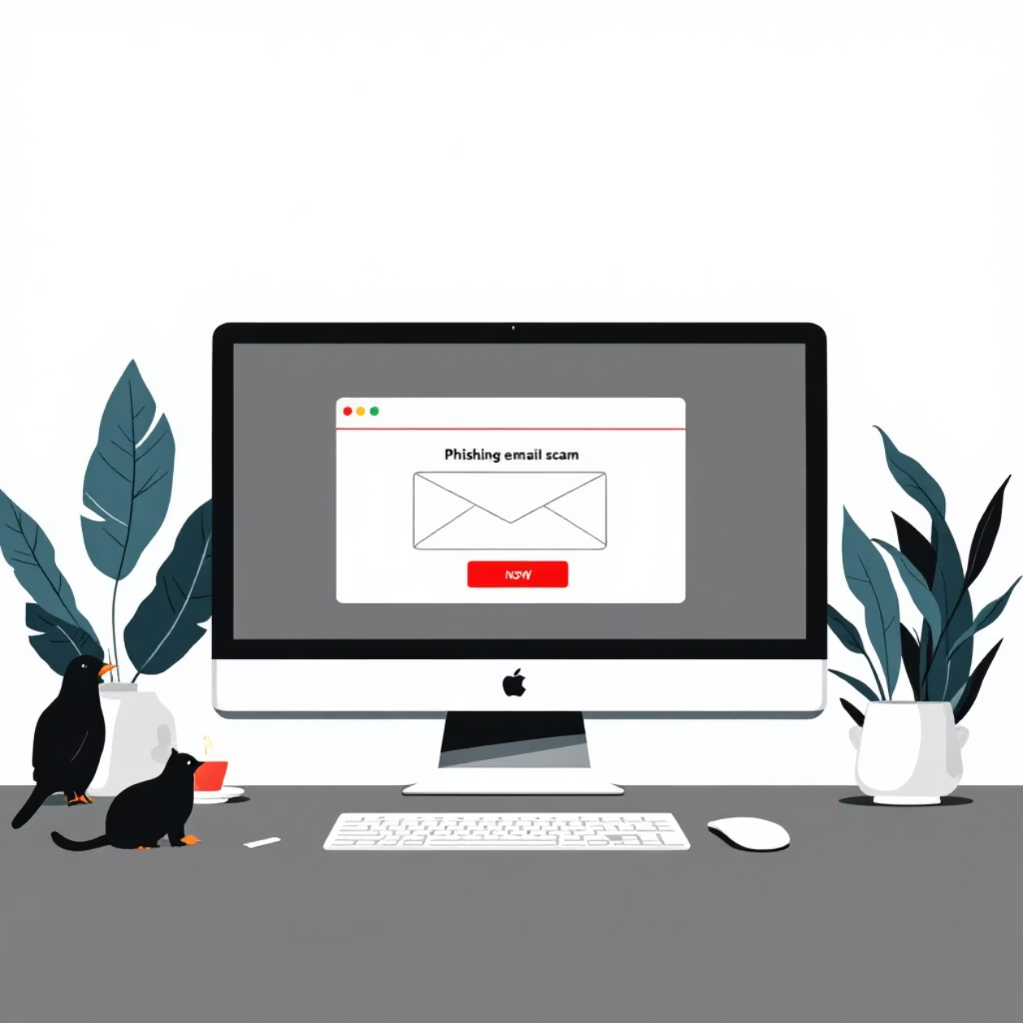
Phishing: The Invisible Threat
Phishing represents one of the most widespread cyberattacks today. Criminals impersonate legitimate entities to steal your sensitive information.
How it works:
Fraudulent emails imitating well-known companies
Text messages with malicious links
Fake websites resembling real platforms
Urgent requests creating panic

Slide 3
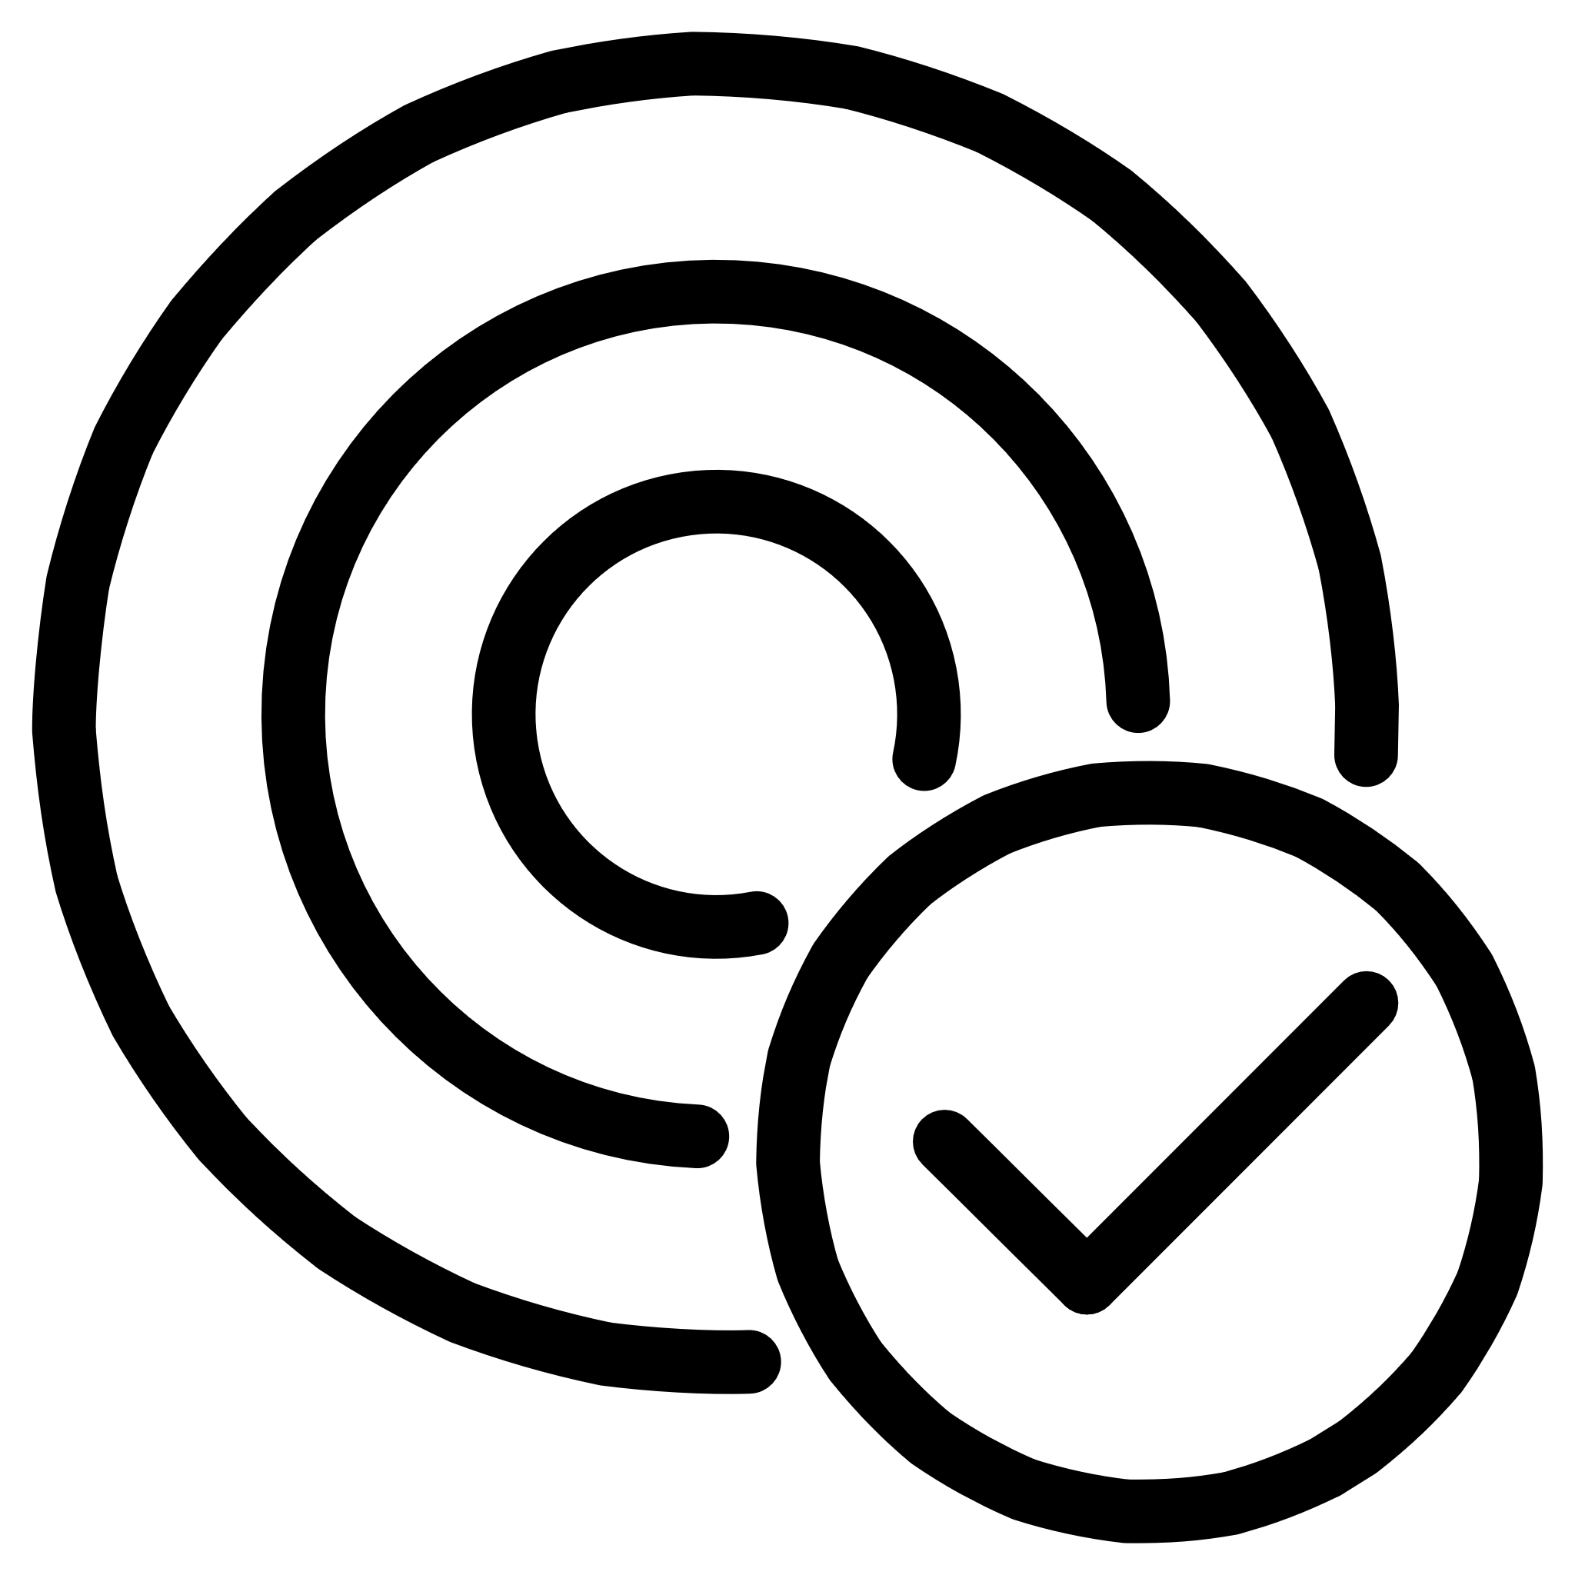
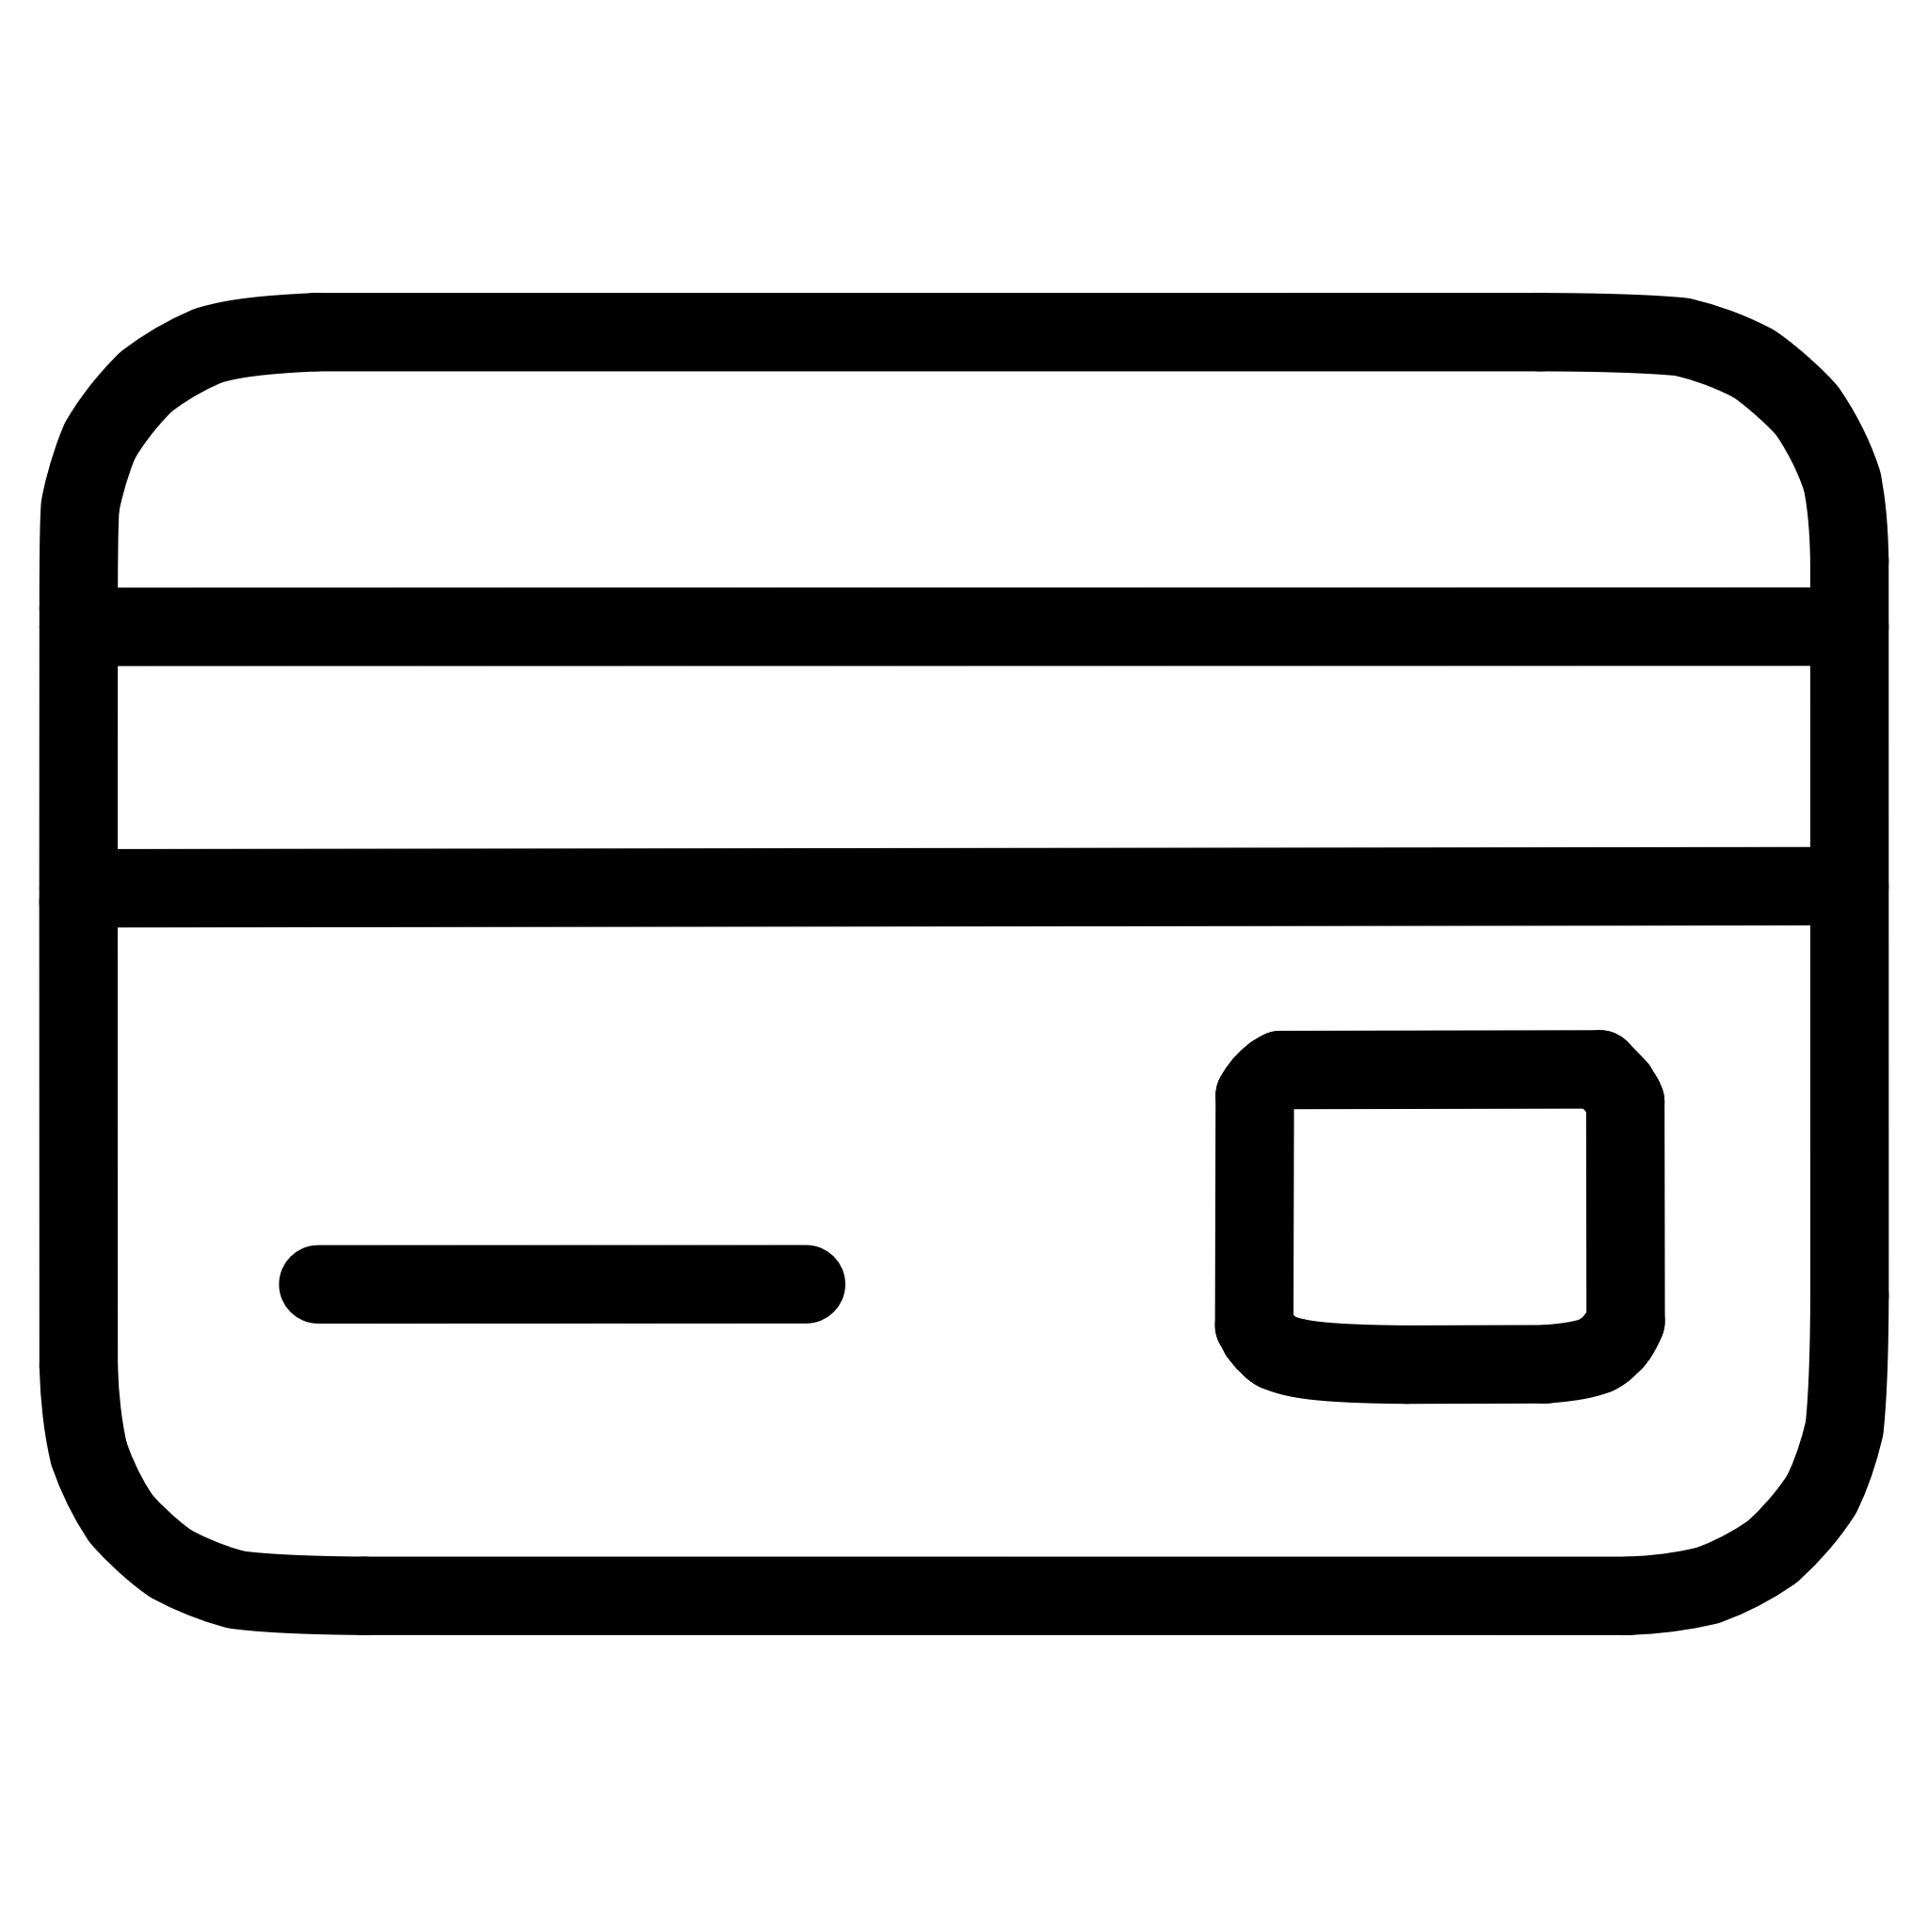


Cybercriminals' Objectives and Targets
Personal Information
Financial Data
National Insurance numbers, dates of birth, physical
addresses stolen for identity theft
Bank details, credit card numbers,
financial account passwords
Business Secrets
System Access
Intellectual property, business strategies,
sensitive customer data from organisations
Login credentials to infiltrate critical
networks and infrastructure

Slide 4
Common Attack Methods
01
02
03
Phishing Emails
Fake Websites
Social Engineering
Seemingly legitimate messages containing malicious links or attachments
Pages impersonating authentic portals to capture your login credentials
Psychological manipulation exploiting trust and urgency
04
05
Malware
Phone Scams
Hidden programmes that install themselves to steal data
Calls impersonating tech support or authorities

Slide 5
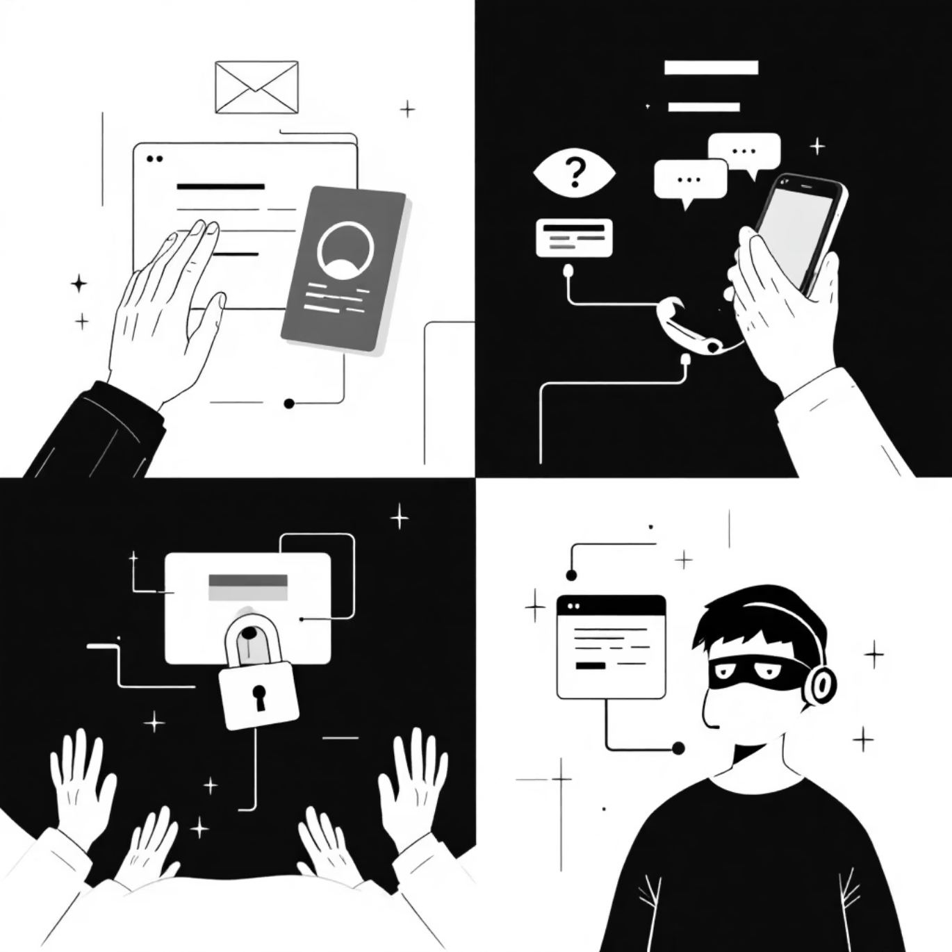
Social Engineering: The Art of Manipulation
Social engineering exploits human psychology rather than technical vulnerabilities. Attackers manipulate emotions to bypass defences.
Common Tactics:
Artificial Urgency: "Your account will be closed in 24 hours"
False Authority: Impersonating a boss or technician
Emotional Bait: Offers that are too good to be true
Deceptive Familiarity: Using public information to gain trust

Slide 6
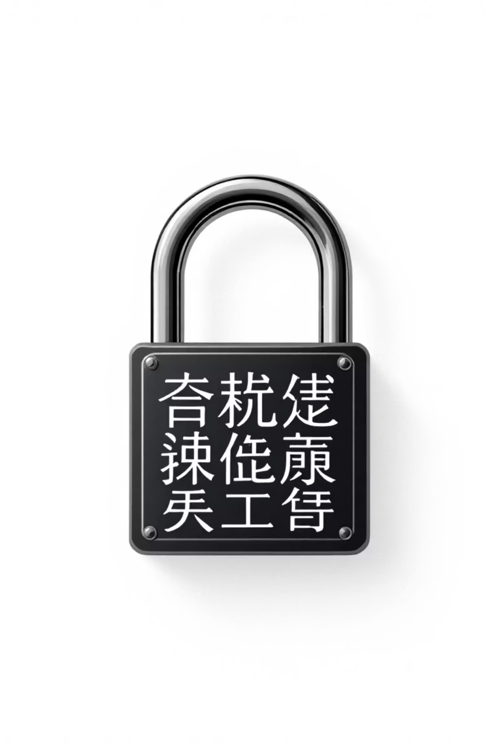
Password Security: Your First Line of Defence
Why Strong Passwords are Essential
Characteristics of a Good Password
Minimum 12 characters (ideally 16+)
A robust password is your primary barrier against unauthorised access. Hackers use automated programmes capable of testing millions of combinations per second.
Mix of uppercase, lowercase, numbers, and symbols
No dictionary words or personal information
Unique for each important account
Password Managers
These tools generate and securely store complex passwords. You only need to remember one master password to access all others.

Slide 7



Multi-Factor Authentication (MFA): Enhanced Protection
What is MFA?
Multi-factor authentication adds an extra layer of security by requiring two or more pieces of identity evidence before granting account access.
The three authentication factors:
Something you know: Password or PIN
Something you have: Phone, security key, card
Something you are: Fingerprint, facial recognition
99%
Attack Reduction
MFA blocks 99% of automated fraudulent access attempts.
67%
Growing Adoption
Businesses using MFA to protect their systems.

Slide 8
Advantages and Risks: A Comparative Analysis
✓ Advantages of Good Practices
✗ Risks of Negligence
Protection of personal and financial data
Identity theft and financial fraud
Drastic reduction in hacking risk
Significant direct economic losses
Peace of mind in your online activities
Compromise of professional accounts
Compliance with professional security standards
Exposure of sensitive data belonging to others
Protection of your digital reputation
Reputational damage that is difficult to repair

Slide 9
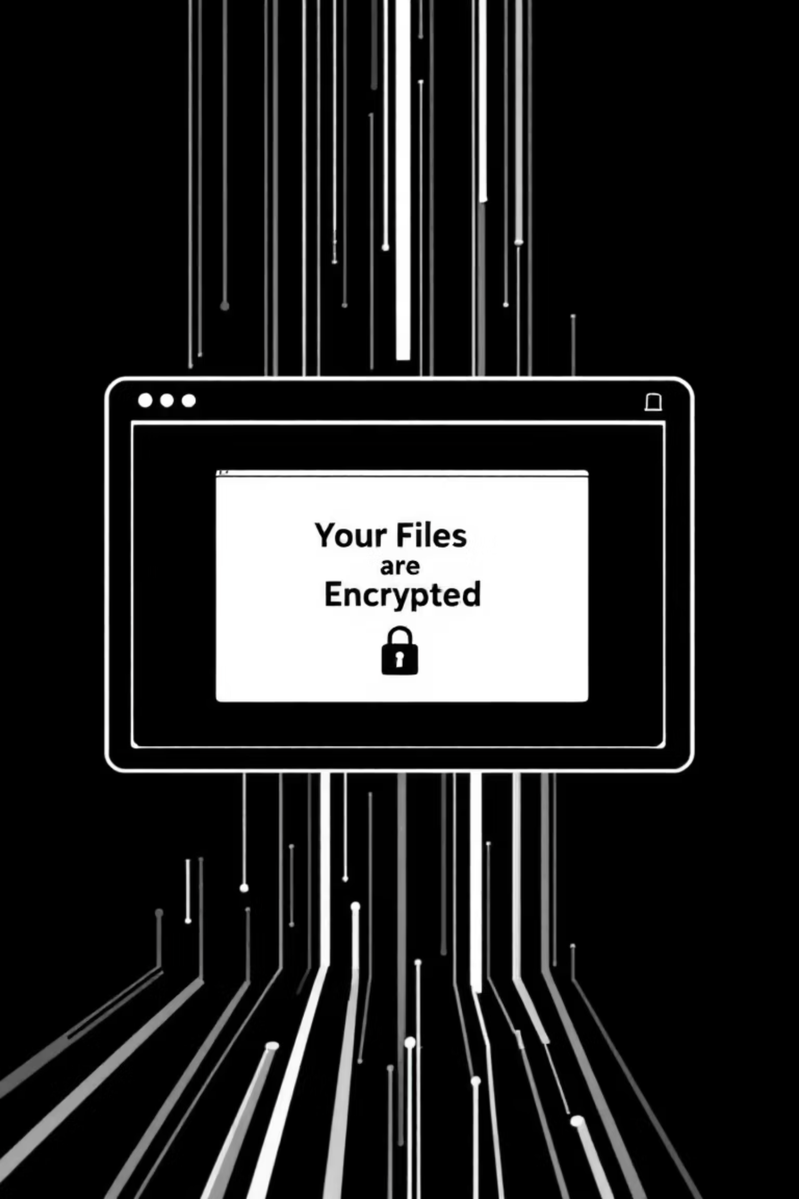
Ransomware and Encryption: Digital Hostage-Taking
How Ransomware Works
Ransomware Protection
Ransomware is malicious software that encrypts your files, making them inaccessible. Attackers then demand a ransom to provide the decryption key.
Regular backups on disconnected media
Infection Vectors:
Prompt system updates
Up-to-date antivirus software
Infected email attachments
Compromised websites
Training on threat detection
Access restrictions based on the principle of least privilege
Unpatched security vulnerabilities
Pirated software downloads

Slide 10





Take Action Today
Enable MFA everywhere
Audit your passwords
Secure all your important accounts with multi-factor authentication
Identify and replace weak or re-used passwords
Remain vigilant
Create backups
Beware of suspicious messages and always verify authenticity
Protect your essential data against ransomware
Cybersecurity is everyone's business. By applying these simple yet essential principles, you significantly reduce your exposure to digital threats. Vigilance and prevention remain your best allies.

